Slide 1

Lecture 15
Chemical Engineering for Micro/Nano Fabrication
100 nm

Slide 2
Types of wetting
Red block prefers to interact with the air
n*L₀
(n+1/2)* L₀
PTMSS Preferential Surface
PS Preferential Surface
Symmetric wetting
Asymmetric wetting
Coulon et al., Macromolecules 1989, 22, 2581.
Russell et al., Macromolecules 1989, 22, 4600.
Coulon et al., J. Phys. (Paris) 1990, 51, 2801.

Slide 3
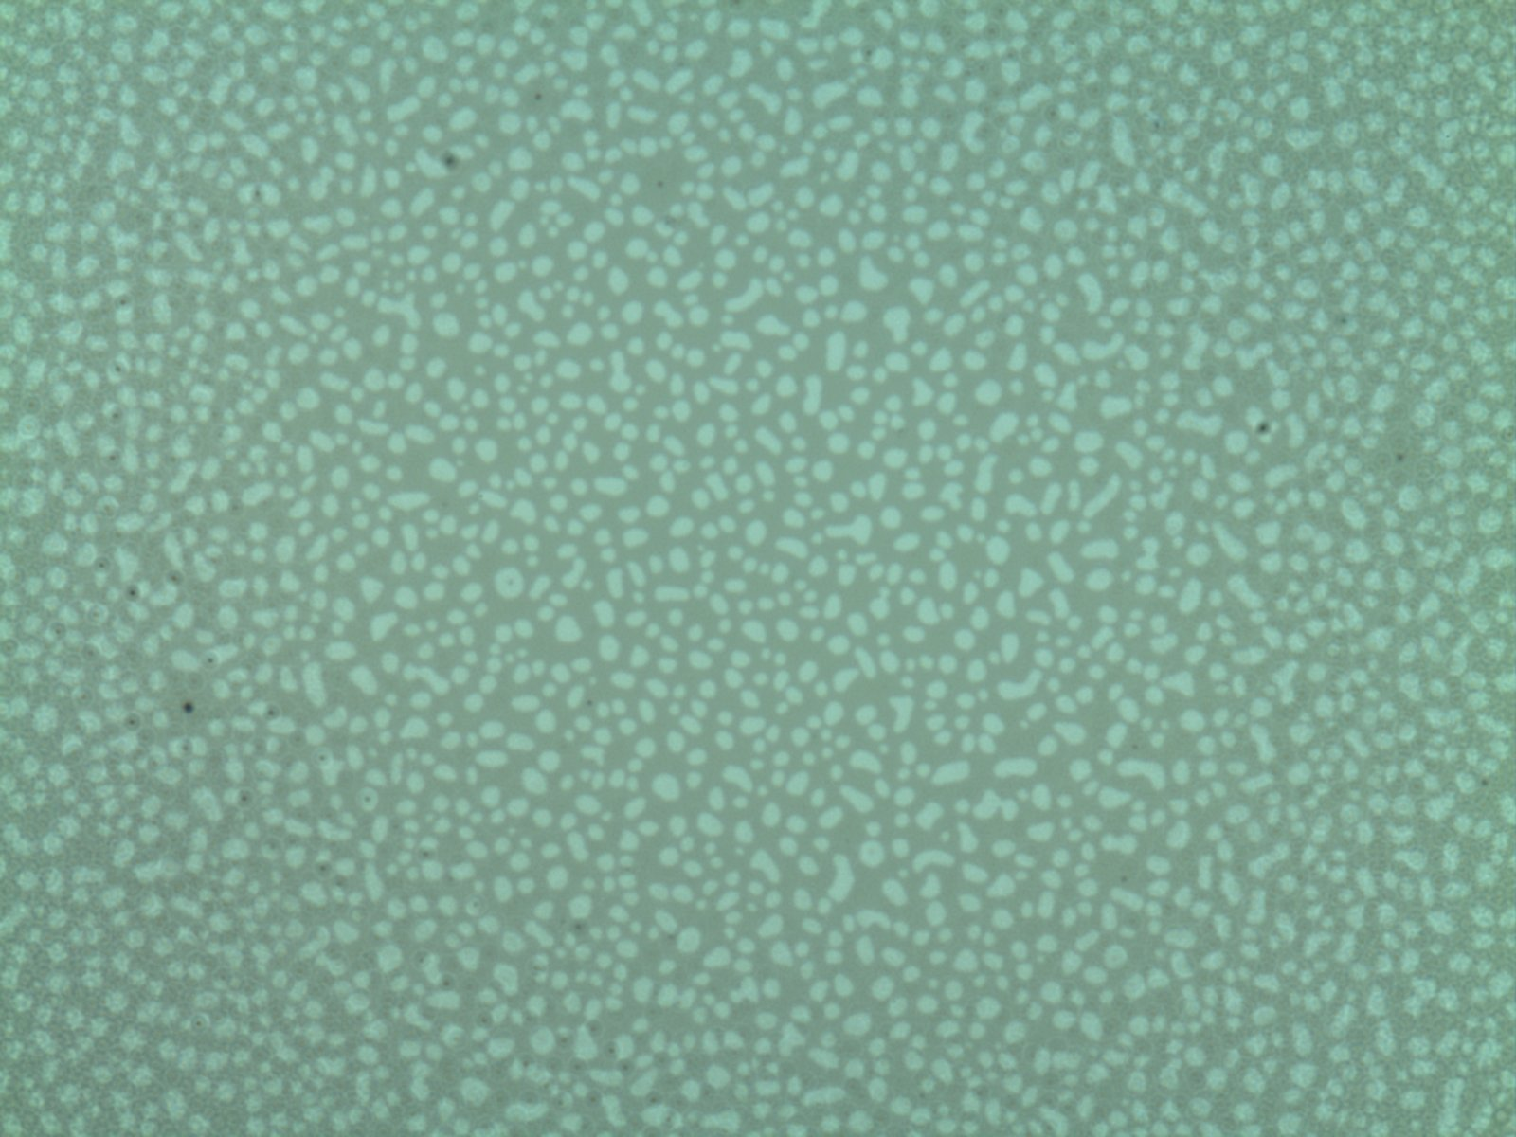
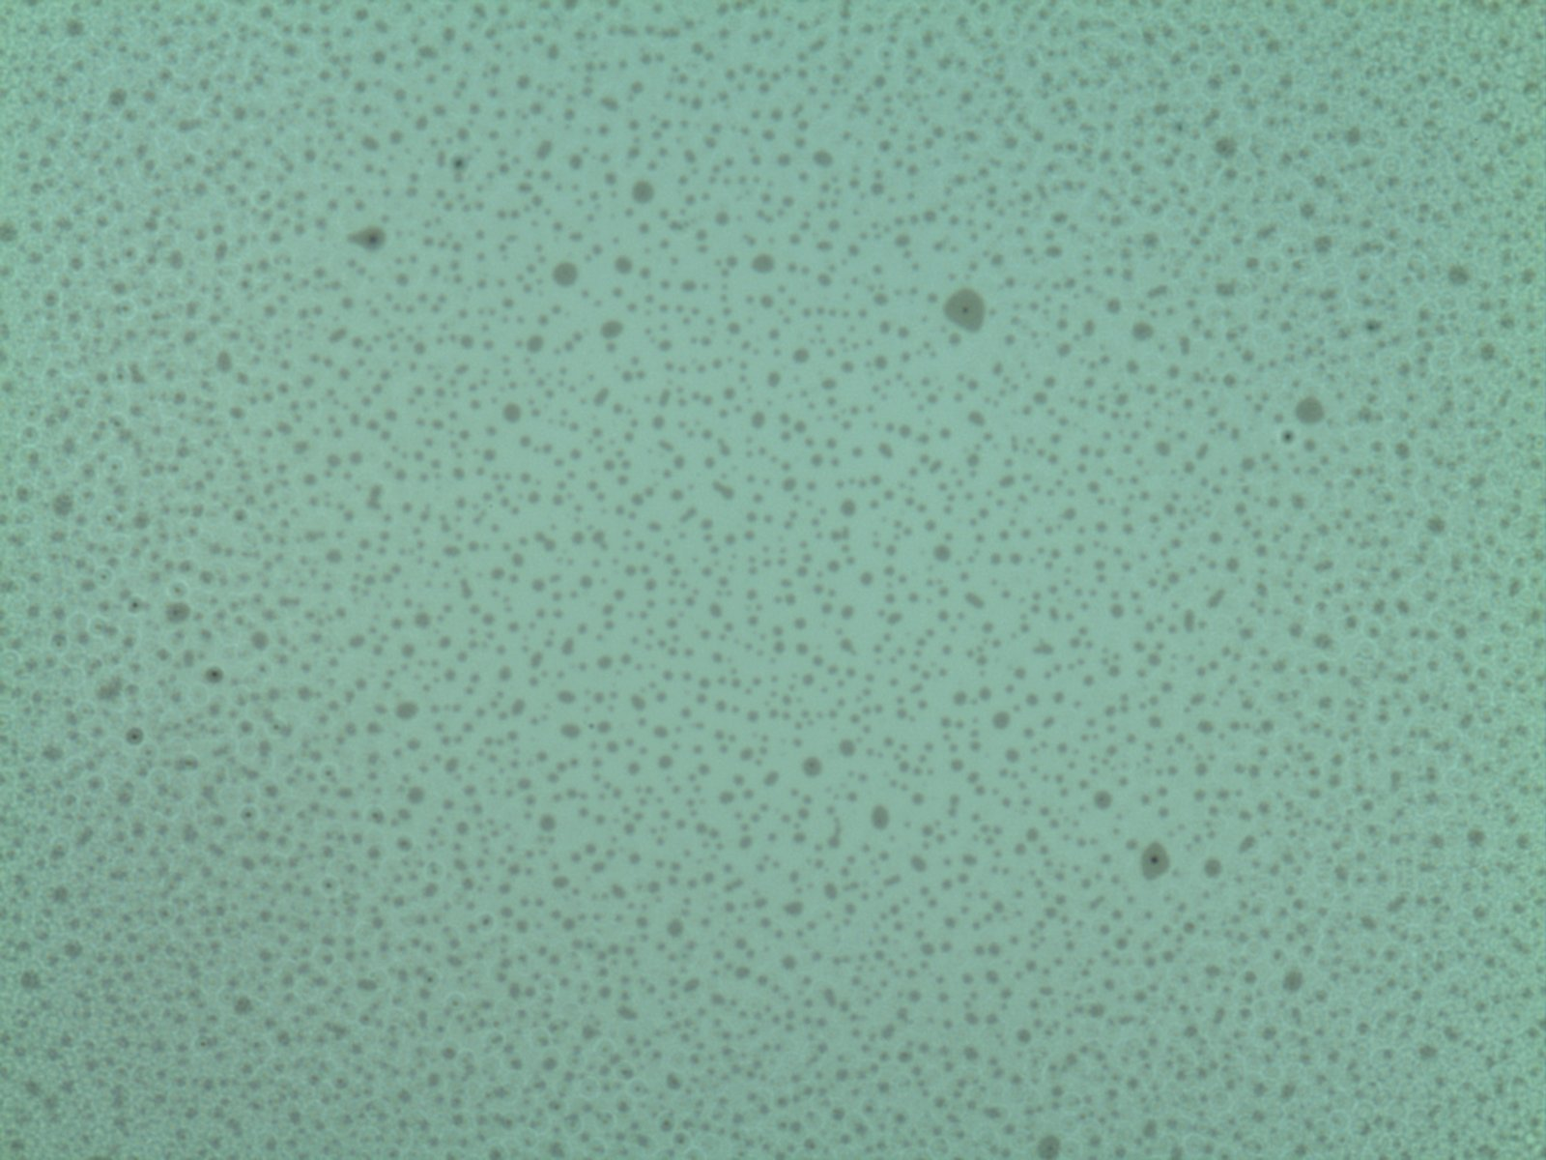
Island / hole analysis
Red block prefers to interact with the air
1 L₀ Holes
1 L₀ Islands
5 µm
1.5 L₀
1.2 L₀
1.0 L₀
100 nm
0.5 L₀
PS Preferential Surface
PTMSS Preferential Surface
Scale bars are 5 µm
Mansky et al., Macromolecules 1997, 30, 6810 , Huang et al., Macromolecules 1999, 32, 5299,. Peters et al., Langmuir 2000, 16, 4625.

Slide 4
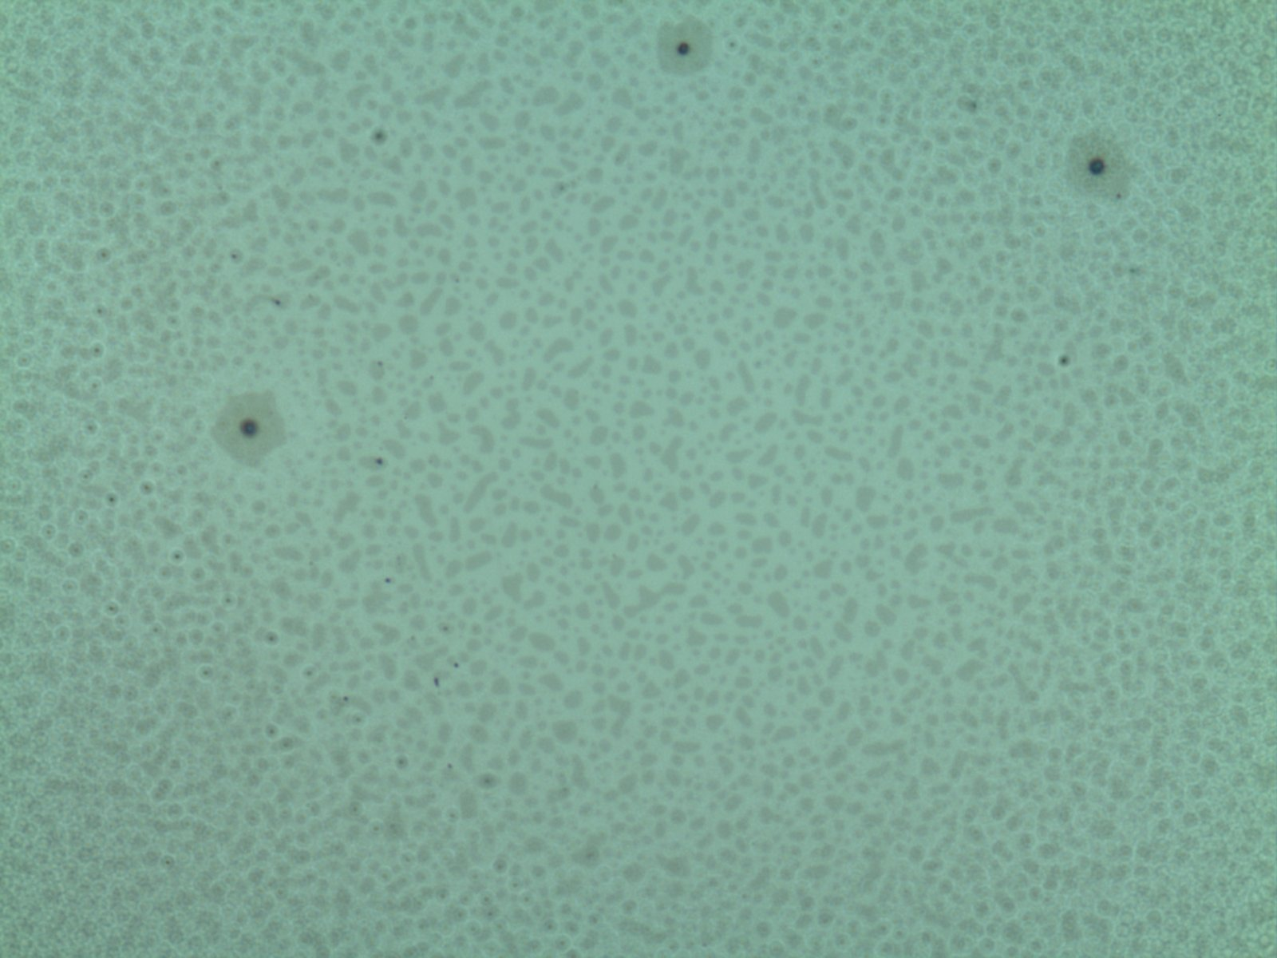
Finding the neutral composition
Surface treatment:
Initial BCB thickness: 1.15 L₀
Percent PtBuS:
48%
52%
65%
Result:
1 L₀ Holes
PS wetting
0.5 L₀ Islands
PS and PTMSS wetting!
1 L₀ Islands
PTMSS wetting
0.5*L₀
?
5 µm
Neutral
Wafer
Scale bars are 5 µm

Slide 5
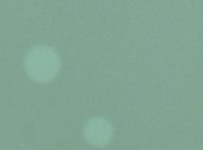
Half L₀ features on a neutral surface
1.17 L₀
0.5 L₀ Islands
1.35 L₀
0.5 L₀ Holes
1.5 L₀
1.25 L₀
100 nm
1.0 L₀
Neutral Surface
Neutral Surface
Kim et al. ACS Nano. 2013, 7, 9905.
Scale bars are 5 µm

Slide 6
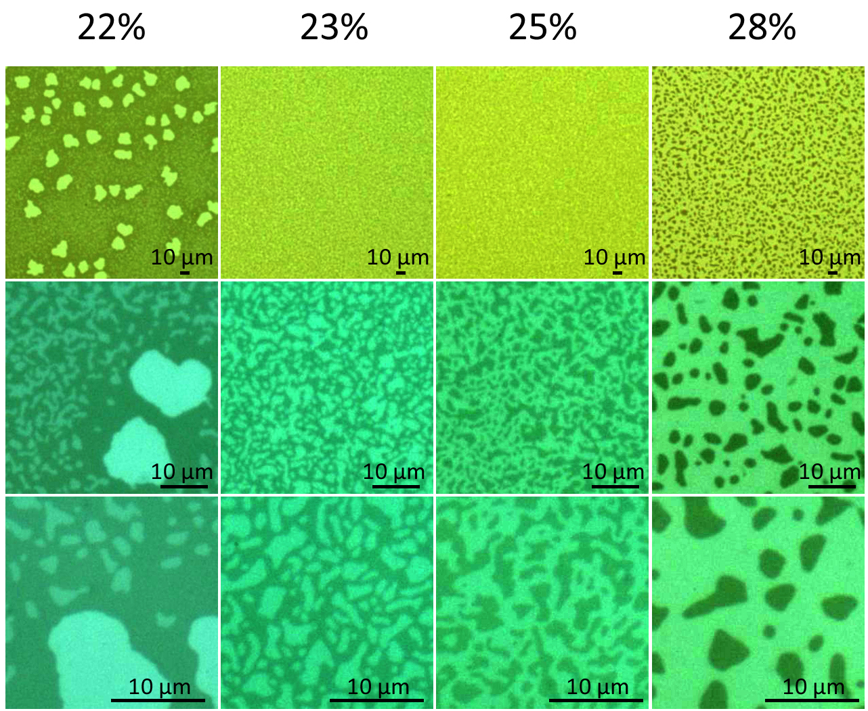

Slide 7
Top Interface Challenge
Not Soluble in H₂O
Soluble in H₂O
H₂O
γ
(mN/m)
25
33
Ideal neutral surface
Polar solvent
solubility threshold
40
72

Slide 8
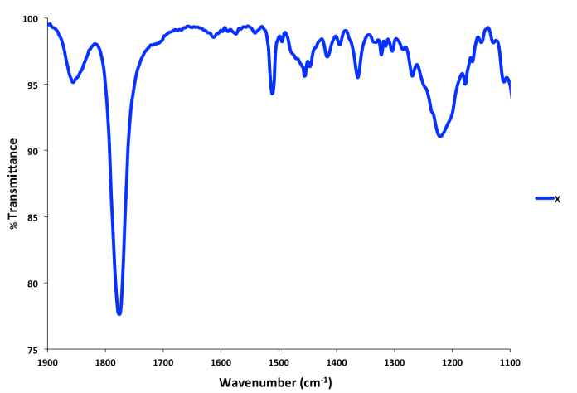
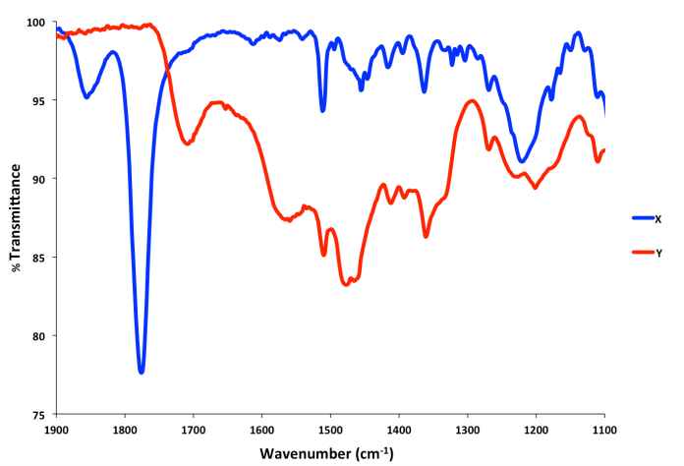
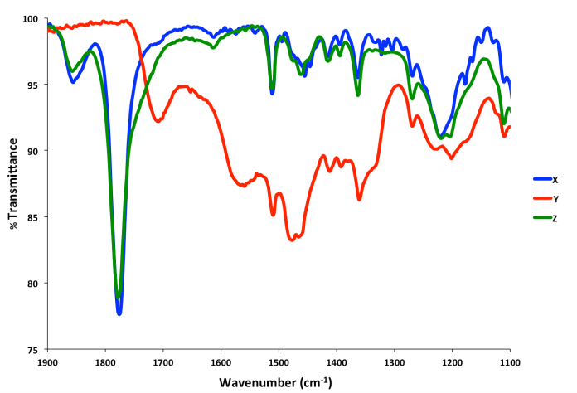
Top Coat Chemistry
Requirements
1. Polarity switch
2. T_{g} greater than blocks
  PS = 105 ˚C
  PTMSS = 135˚C
3. Surface energy control

Slide 9
Top Coat Design
a b
Mol fraction:
0.5
a + b = 0.5
PTMSS Preferential
Neutral
PS Preferential

Slide 10
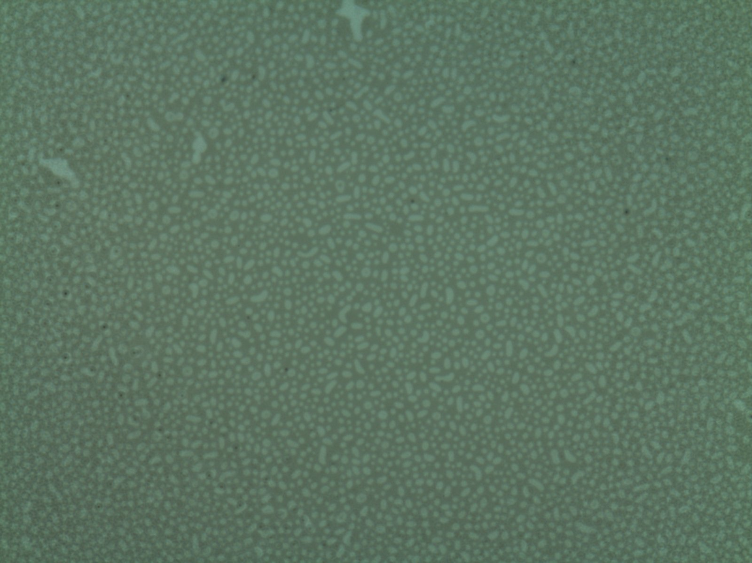
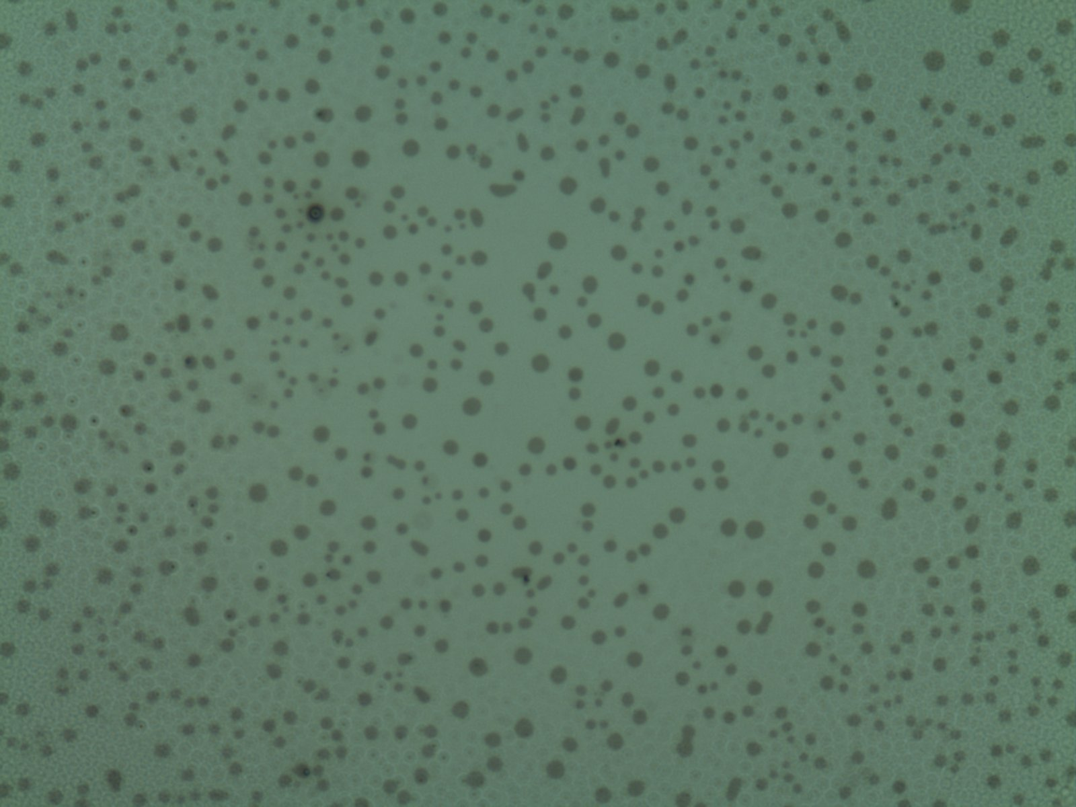
Confined Island Hole test
5 µm
5 µm
Holes
Islands
1.5 L₀
PTMSS Preferential Top Coat
PS Preferential Top Coat
1.2 L₀
1.0 L₀
PS Preferential Surface
PS Preferential Surface
Scale bars are 5 µm

Slide 11
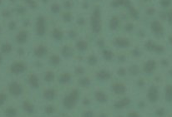
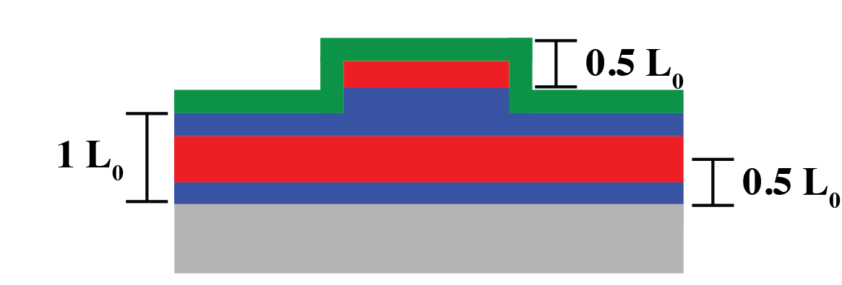
Confined island hole results for 22 nm diblock
Initial BCP thickness: 1.19 L₀
Top Coat:
LD 2-287
~ 1.40 L₀
49% di-tBuS
25% di-tBuS
12% di-tBuS
5 µm
5 µm
5 µm
5 µm
5 µm
22 nm holes = 1 L₀
10 nm islands = 0.5 L₀
5 µm
22 nm islands = 1 L₀
5 µm
5 µm\
PTMSS wetting
PS wetting
PS wetting
PS Wetting
PS wetting
All scale bars = 5 µm
Notes:
Figure SX: (a-d) Optical micrographs, (e-h) AFM height, and (i-l) AFM height traces of PS-b-PTMSS (L₀ ≈ 22 nm) topography formed when confined between a top coat (12, 25, or 49% Pdi-tBu) and PS substrate surface treatment and annealed at 180°C for 6 min. Scale bars represent 5 µm.

Slide 12
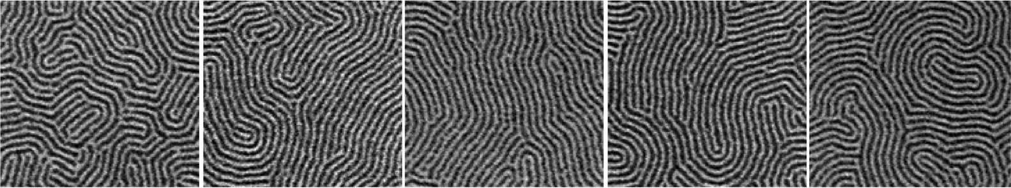
Orientation Results
BCP on
neutral surface
Apply top coat
Anneal
L₀
Etch
PS Preferential Interfaces
Neutral Interfaces
PTMSS Preferential Interfaces
1.0 L₀
1.5 L₀
2.0 L₀
2.3 L₀
3.0 L₀
Maher et al. Chem. Mater. 2014, 26, 1471 All scale bars = 200 nm

Slide 13
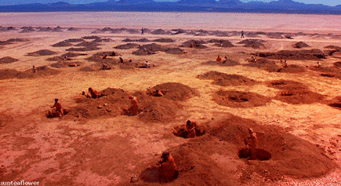
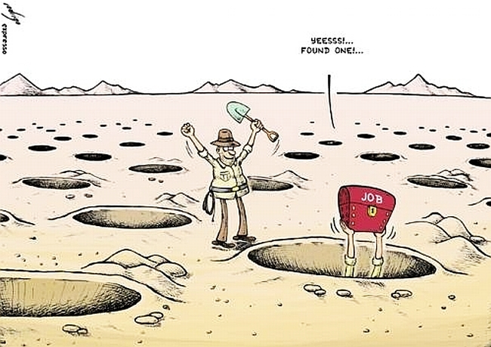


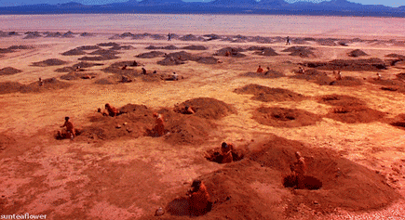
The Search for χ
χ
χ

Slide 14
Determine χ by SAXS
Rheology is also a valuable tool for determination of χ
Durand, et. al Journal of Polymer Sci., 2014

Slide 15
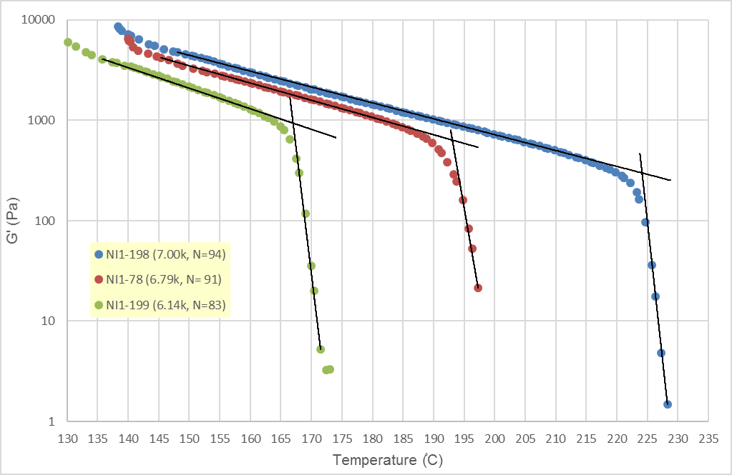
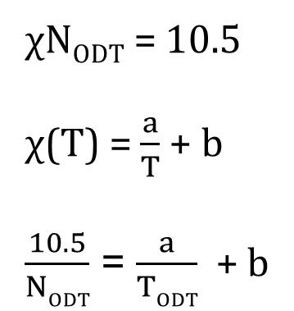
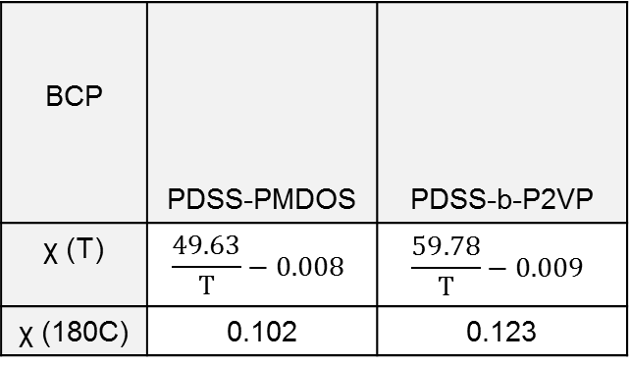
Determine χ by Rheology
χN_{ODT} = 10.5
χ(T) = $\frac{a}{T}$ + b
$\frac{10.5}{NODT}$ = $\frac{a}{TODT}$ + b
BCP | PDSS-PMDOS | PDSS-b-P2VP
χ (T) | $$\frac{49.63}{T}−0.008$$ | $$\frac{59.78}{T}−0.009$$
χ (180C) | 0.102 | 0.123
193 ֯C
224 ֯C
167 ֯C
11

Slide 16
Increasing χ
0.23
0.14
0.11
0.048
0.045
PS-b-PMMA

Slide 17
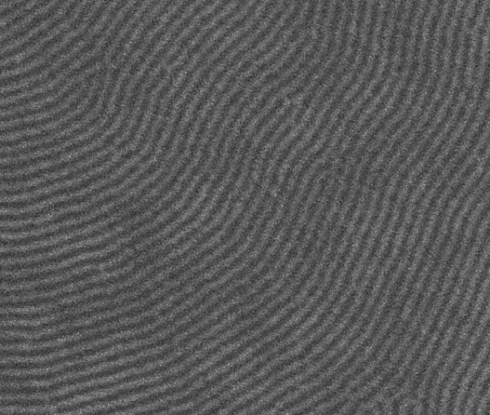
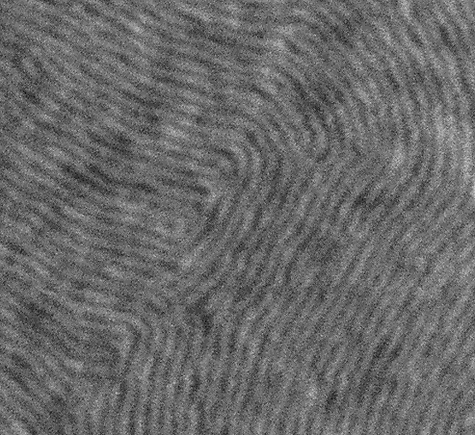
Oriented high χ block copolymers
50 Angstrom lines
40 Angstrom lines

Slide 18
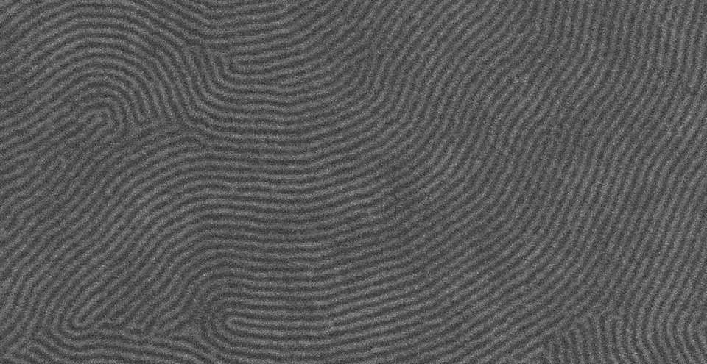
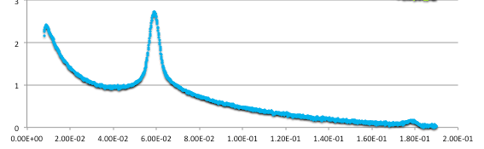

Small Structure for Bit Patterned Media
q=0.00590 → 10.6 nm
50 Angstrom Lines and Spaces

Slide 19
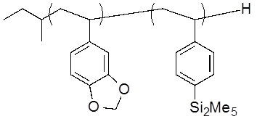
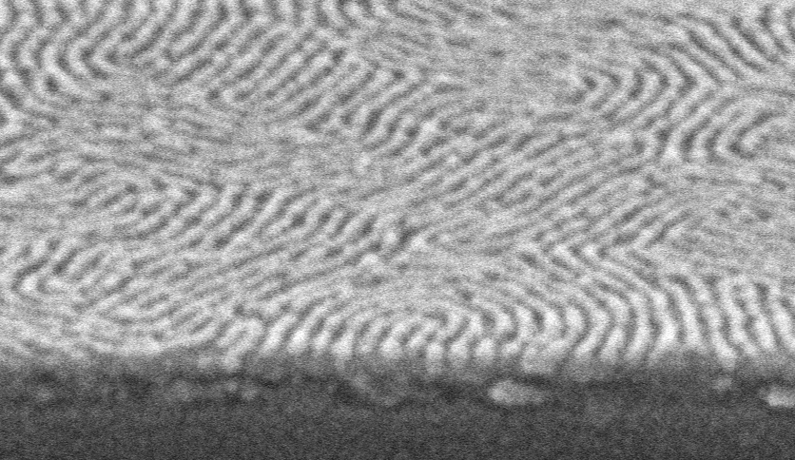

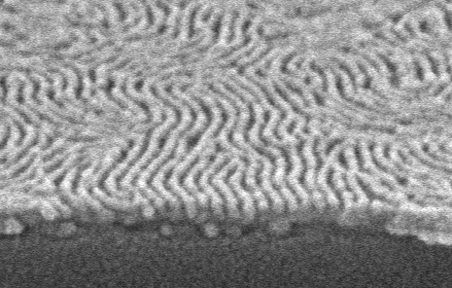

Image Transfer of 50 Å lines and Spaces
BCP etch (CO₂ RIE)
BCP mask + Neutral brush (8 nm)
Chromium (4 nm)
Spin-on carbon (15 nm)
Silicon wafer
Cr/SOC etch (Cl₂/O₂ RIE)
Scale bar = 100 nm

Slide 20
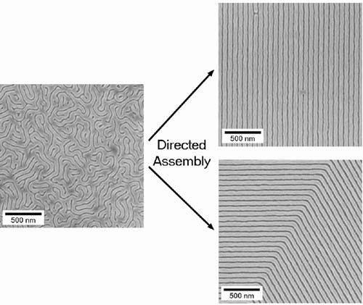
Now…Alignment Control - DSA
Directed Self Assembly
Nealey, Russell, Ross, et al

Slide 21
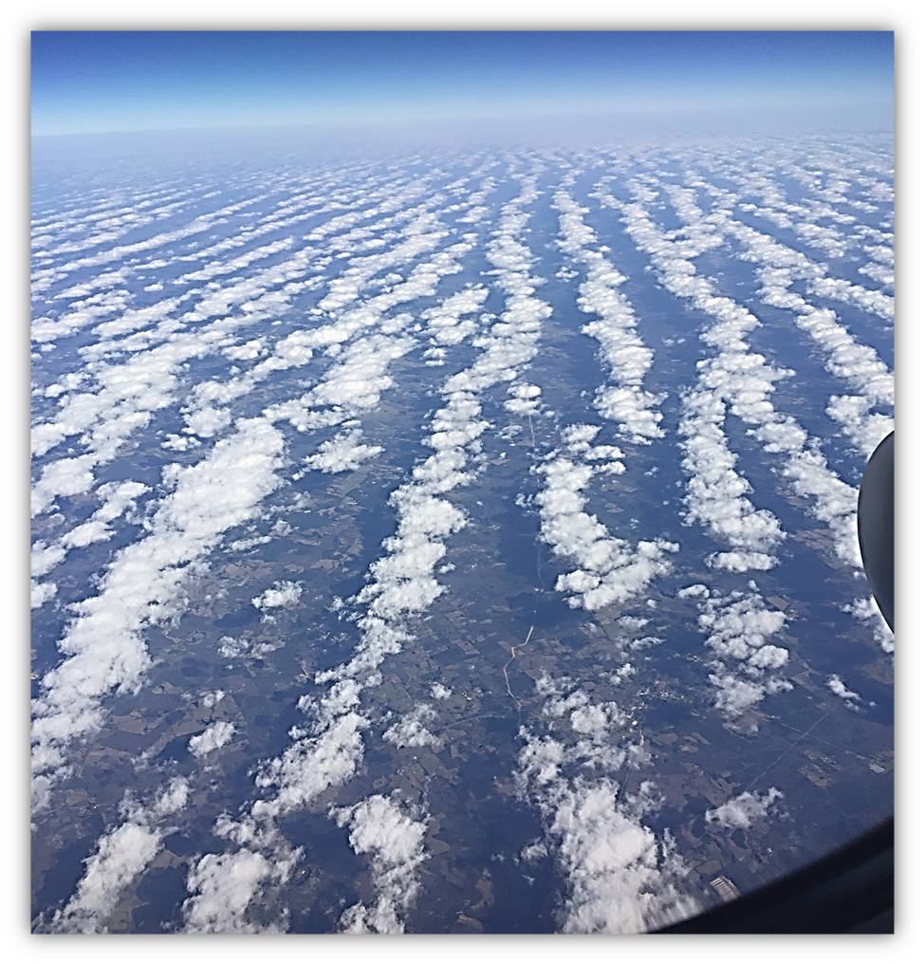
Can we orient these high χ materials
Even Nature struggles with this Challenge

Slide 22
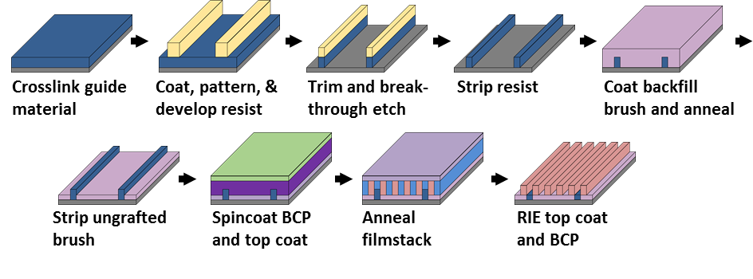
A “Hybrid” process flow created to incorporate top coat and combine chemical and topographic anchoring for DSA
Chemistry of XST
Chemistry of brush:
Chemistry of ~20 nm BCP:
Chemistry of TC:
Blachut, G., et al. Chem. Mater (2016), 28(24), 8951-8961.

Slide 23

Design for n=4 & 0.5L_{o} where L_{o} =20
Challenging Lithography
40nm lines and spaces
Line is subsequently “trim etched” to 10nm
This is the theoretical limit for 193nm immersion litho
Top coat should be perfectly neutral
Brush approaches neutral with increasing multiplication
Guide line should strongly favor one block

Slide 24
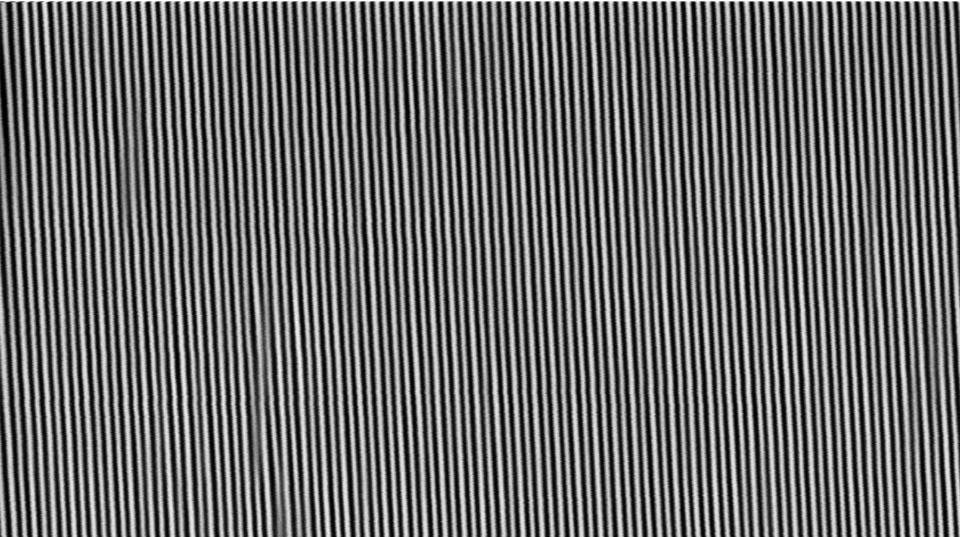
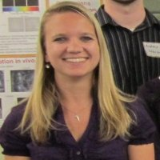

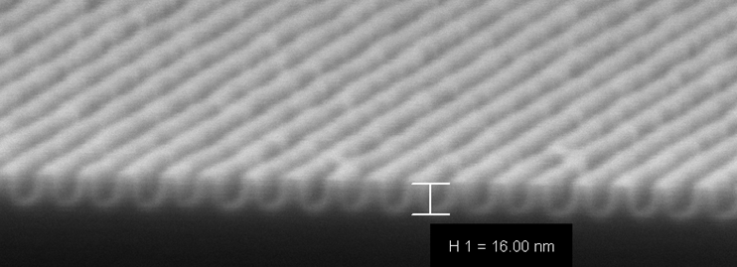

Directed Assembly at HGST
Electron Beam written Guide patterns
10 nm Lines and spaces
Julie
Ricardo
ACS Appl. Mater. Interfaces 2015, 7, 13476

Slide 25


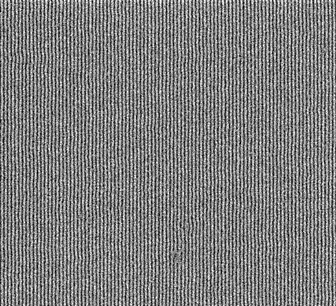


Greg in Belgium!
Gregory Blachut
L₀ = 19.7 nm
200nm
PMOST-PTMSS
Chem. Mater 28(24)8951-8961 (2016)

